Slide 1
8 worries for sleepless nights
(and what we can do about them)
+ 2 reasons for a good night sleep
Jim Kurose
Distinguished University Professor
University of Massachusetts
College of Information and Computer Sciences
Notes:
In my fifth year, so know some of you are well; others of you are new.
Also: rotator from Umass, worked with our VCRE
Also MGHPCC
Also CASA

Slide 2
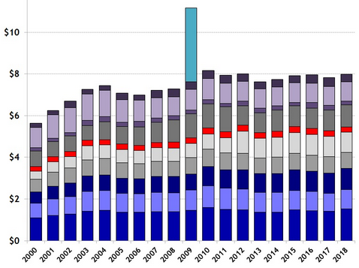
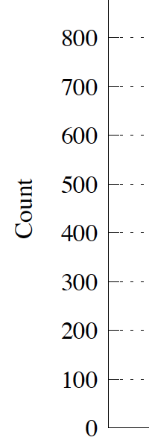
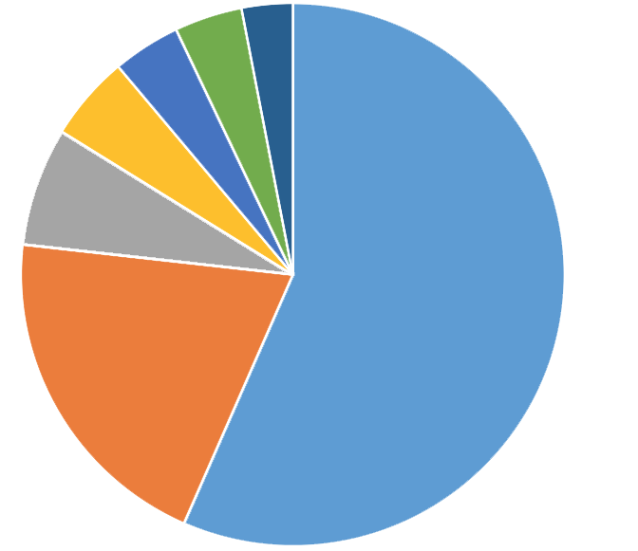
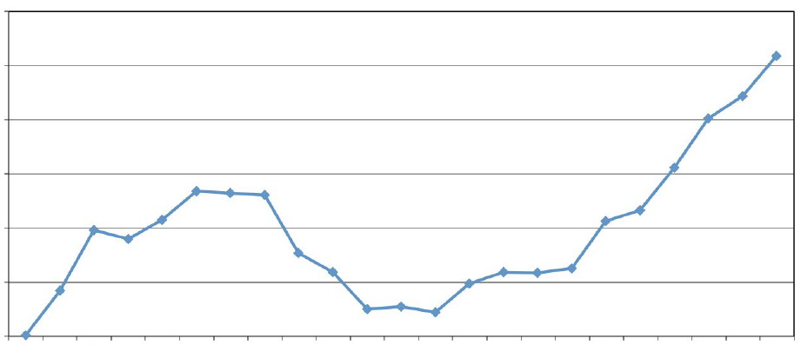
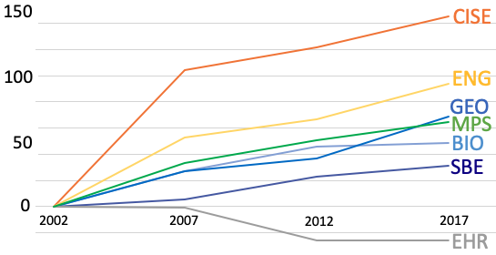
Relatively Flat Funding,
Exploding opportunity
1
Social sciences
Math
Physical sciences
4%
3%
Life sciences
4%
5%
Life, physical, soc. sci. technicians
Advertised tenure track positions in CS (Wills, 2018)
7%
NSF Budget (AAAS, constant 2019 $)
Engineers
Computer occupations
40K
20%
30K
56%
20K
Job Openings 2016 – 2026:
National growth and replacement
(US Bureau of Labor Statistics)
10K
1997
2007
2017
Newly Declared Undergraduate CS, CE, I Majors (CRA)
Increase in number of PhDs awarded by STEM Discipline (2002-2017). NSF 19-03
Notes:
First set have to do about funding. Money matters!

Slide 3
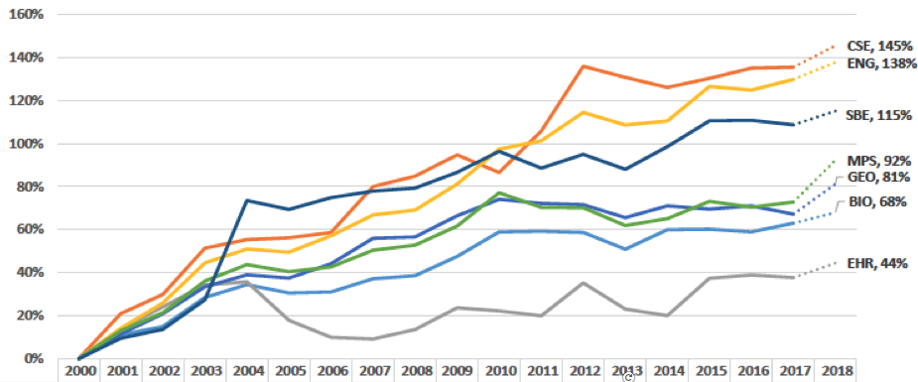
By some measures CISE has done well, but …
2
% Change in Funding
NSF Directorates
2000-2018
… and high quality proposed research goes unfunded across all directorates
Notes:
First set have to do about funding. Money matters!

Slide 4
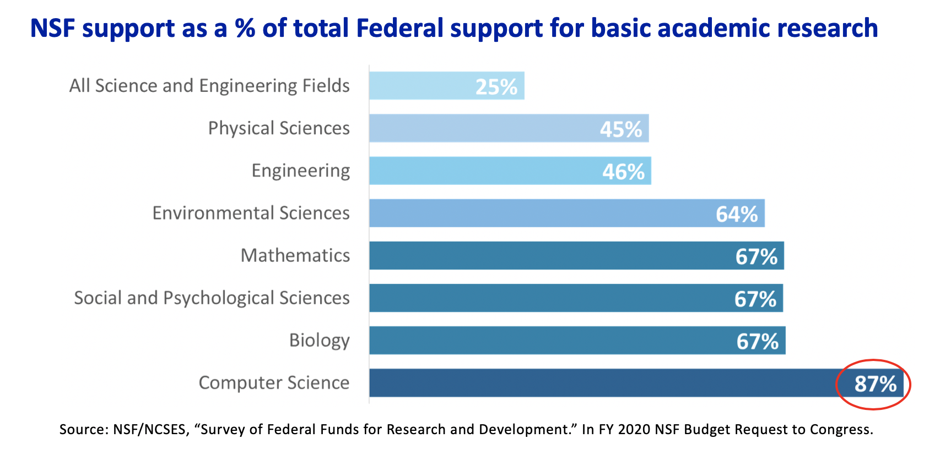
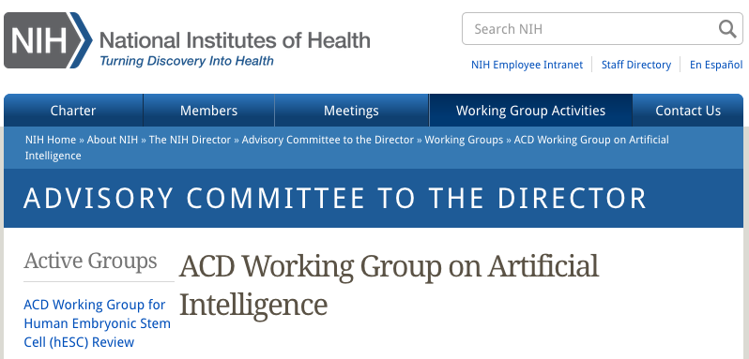
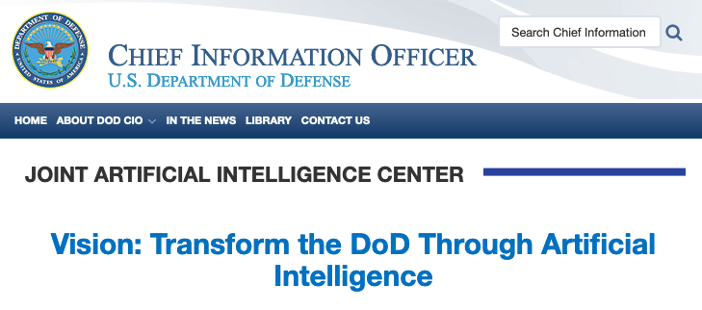
87%
3
NSF funds a very large proportion of Federal basic CS research. Mission agencies are expanding AI activities in their application domains. What portions of that goes to CISE academic research is TBD.
Notes:
First set have to do about funding. Money matters!

Slide 5
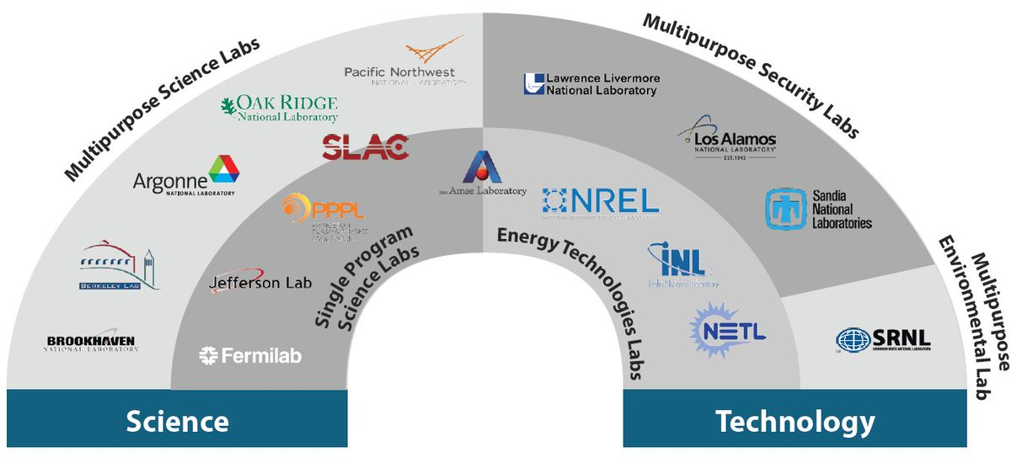
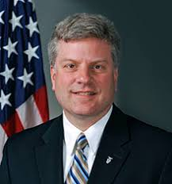
Funding Agencies: NSF and other agencies
4
Many Federal agencies have “lifers” leading the agency. They have deep experience, many contacts, and know how to “work the system”. By comparison, NSFer leadership are “short-termers”
But NSF DADs, DDDs are invaluable, generally long-term, Federal employees
Other Federal agencies have organizations that promote their good work within the Beltway.
Notes:
First set have to do about funding. Money matters!

Slide 6
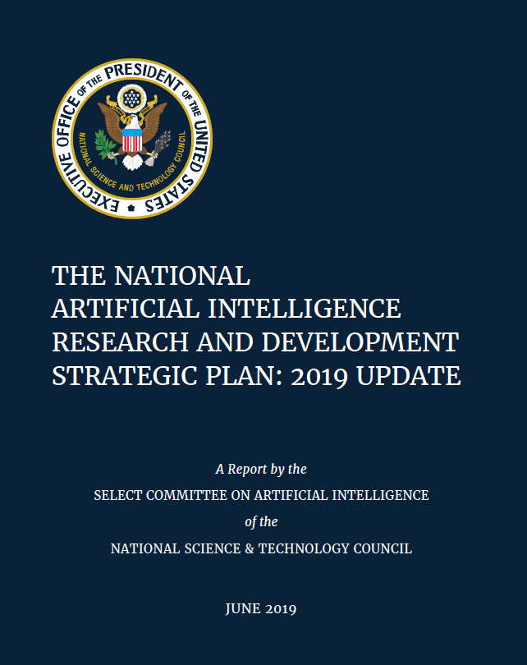
5
Academic versus industry research: the public (and others) don’t quite get it
Well-known that industry R&D vastly outspends Federal CS investments (Amazon, Google, Microsoft: $22B, $16.2B, $14.7B)
Heard in the corridors of NSF (not CISE) : “with so much money being invested in CS research by industry, how can NSF hope to make a difference?”
Need to continue to make case for the value proposition for academic CS research that’s funded by the Federal Government, or jointly with industry
But not a top 3 priority for any lobbying organizations (university, or industry)
Notes:
First set have to do about funding. Money matters!

Slide 7
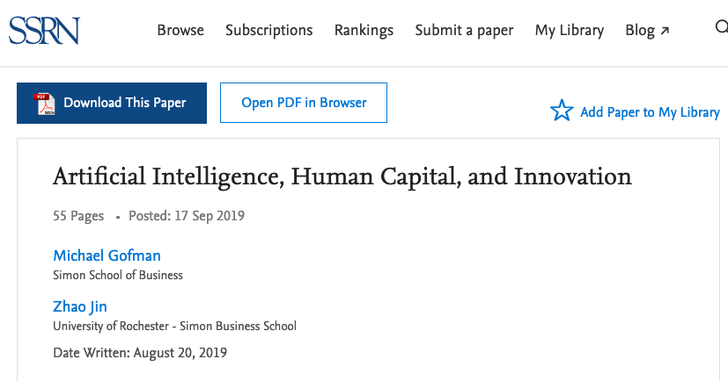
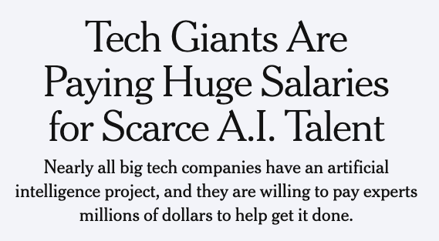
Eating our Seedcorn
6
Notes:
First set have to do about funding. Money matters!

Slide 8
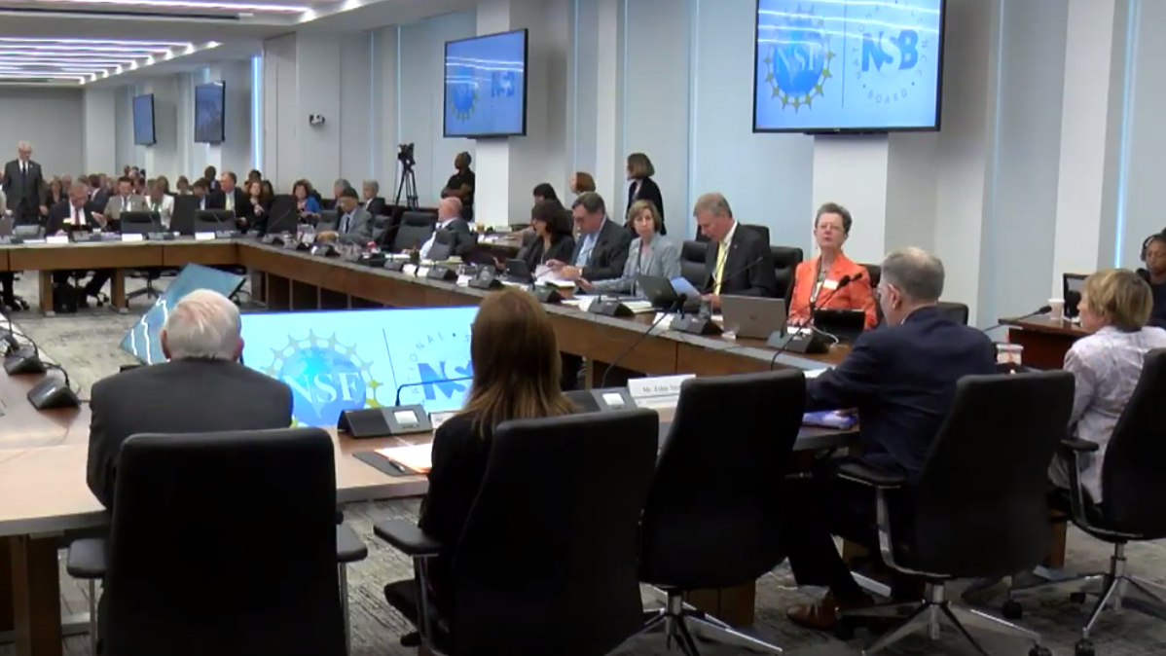
Science and Security
7
Take seriously the concern that foreign governments may be targeting US research to gain advantage over US interests
Articulate how US has benefited immeasurably from its open research system (share findings, attract top students and researchers)
Important to have people (with clearances) who know academia and Federal research agencies “in the room”
US law, policy must strike right balance between openness, protection
Restrictions must be well targeted, not undermine fundamental strengths of US system
US must invest sufficiently in our own R&D, make it easier and more desirable for those we educate to remain in US
https://www.youtube.com/watch?v=lqO0-8vN-2M (46:45 onwards)
8
Notes:
First set have to do about funding. Money matters!

Slide 9
Federal (NSF) grants and promotion
8
“Securing competitive research is a critical requirement for tenure and promotion at X.”
From: A CS Department chair’s 3-year “mid-term” review case analysis
Heard (in person) from many early career faculty that getting a CAREER grant is seen as “bar” for getting tenure
Funding seen as “an end” not a “means” ($) towards an end (great research)
Funding decisions based in part on many factors (including portfolio balance) not an absolute measure of research quality.
Funding is getting harder (and harder) to get
9
Notes:
First set have to do about funding. Money matters!

Slide 10
And there are other worries ….
8⁺
Always a worry about getting good people to come to DC (even for a short stay, much less a long stay)
Coherence, support needed for scaling CS undergraduate education
5-year STEM Ed plan: focus on training (not undergrad or graduate)
But there is great cause for optimism! ….
10
Notes:
First set have to do about funding. Money matters!

Slide 11
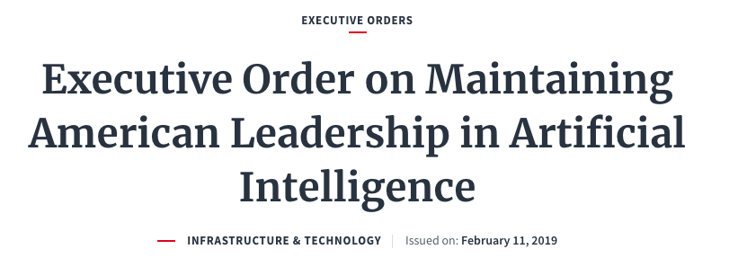
8
9
Our message is great, and being heard many places
National economic competitiveness, national security, national defense … there are today’s calling cards: computing is at the center of this; this is recognized on all sides
Artificial Intelligence, Quantum Information Science, and Computing: .. prioritize basic and applied research investments that are consistent with the 2019 Executive Order on Maintaining American Leadership in Artificial Intelligence … prioritize R&D advancing fundamental QIS, building and strengthening the workforce, engaging industry, … work together to explore new applications in and support R&D for high performance future computing paradigms, fabrication, devices, and architectures alongside sustainable and interoperable software; data maintenance and curation; and appropriate security. Support the development and deployment of advanced communications networks by prioritizing R&D
Nat. Security Commission on AI
Notes:
First set have to do about funding. Money matters!

Slide 12
8
9
Our message is great, and being heard many places
CISE Advisory Committee
Advisory Committee for Cyberinfrastructure
Committee(s) of Visitors
NSF-wide: CEOSE, ERE

Slide 13
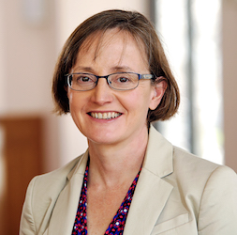
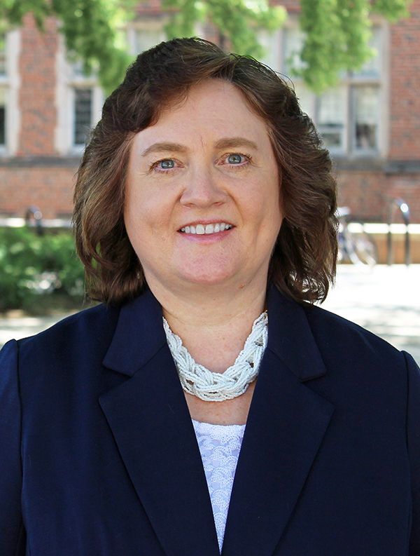
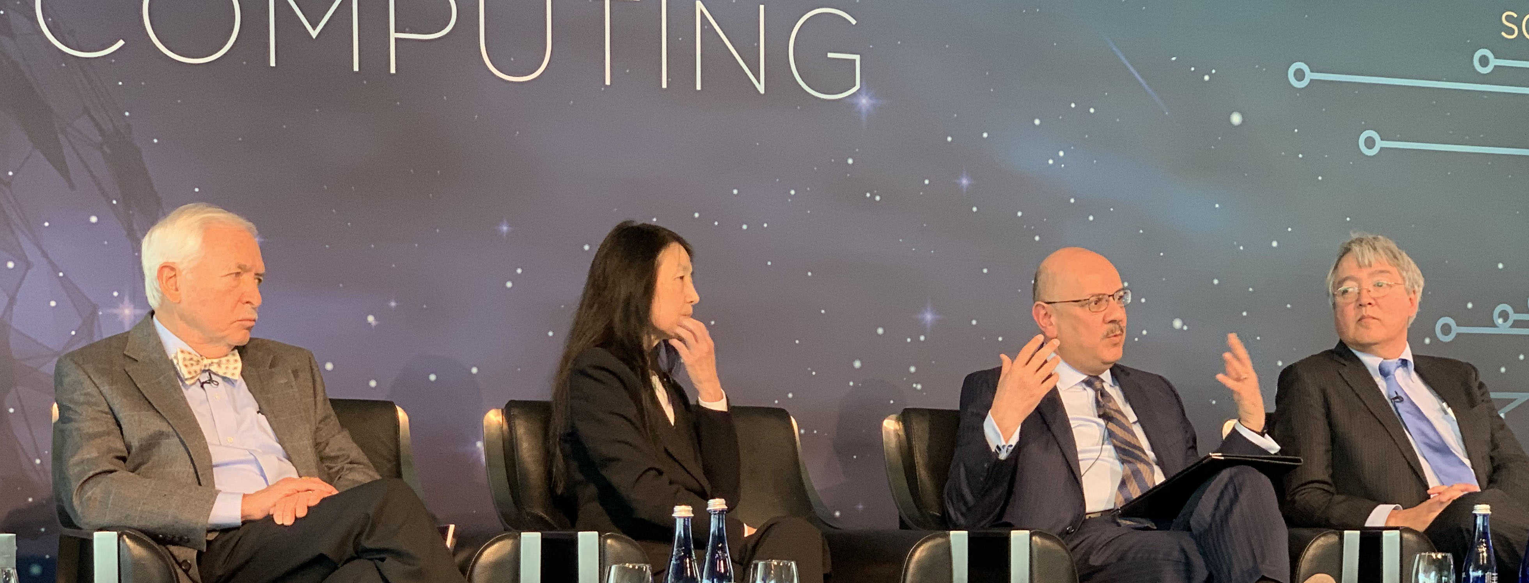
8
10
We have a growing group of politically-savvy CS researchers in DC
Need to retain politically-savvy and CS-research savvy people in DC over longer terms

Slide 14
CS Community action
Increased interactions with Congress (staff, NSC AI)
“push,” into addition to responding to “pull”
Retaining politically- and CS-research-savvy people in DC longer
NSF and 87%: engaging other Federal agencies in CS research
Making research funding someone’s top-3 priority
Honing our narrative: updating tiretracks
also: contributions to national security, defense, health
Helping academic CS:
Funding and tenure, eating our seed corn, scaling undergraduate programs

Slide 15
More thanks at http://jimkurose.wordpress.com

